Slide 1
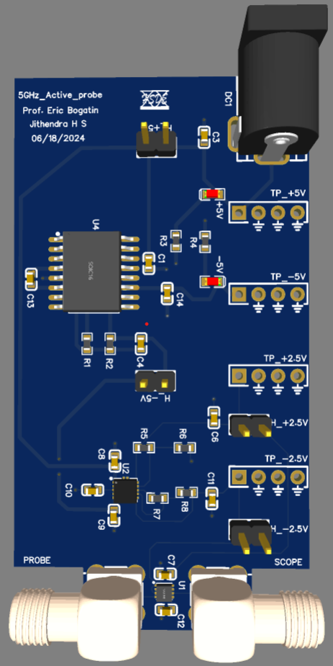
5GHz Active probe
Guided by: Prof. Eric Bogatin
Presented by: Jithendra H S
06/12/2024 Introduction:
Eval board that can support 5GHz bandwidth.
Method to characterize probe and active devices (Opamp).
Support measurement up to signal voltage varying between +1.5V and -1.5V.
Implement board with best practices by taking care of SI issues.
Make use of EasyEDA tool(Free/online tool).
Low-cost probe.

Slide 2
Mini projects
Tasks | Status | Date | Remarks
Working principles of Passive and Active probes | completed |  | None
Simulation with spice | completed |  | Did simulate for LT1054 and opa855, forgot to take screenshots
Component selection and board review | completed | 06/18/24 | Mentioned in next slides
Measure TDR for Wildriver strip and micro strip transmission lines | completed | 06/18/24
Measure gain bandwidth, insertion and return loss for bandpass filters and attenuators using Nano VNA. | completed | 06/19/24
Design DC blocking for RF opamp circuits | completed | 06/25/24 | Preferred using high capacitive value(20uF) so that it can be reused for low pole frequency ckts
Measure input impedance and output impedance of RF opamps | completed | 07/10/24 | Measured, yet to figure out from plots
Measure gain bandwidth of few RF opamps using VNA(measure S21) | completed | 07/10/24 | Measured, yet to figure out from plots

Slide 3
Contd
Tasks | Status | Date | Remarks
Design breakout boards with LT1054 and TPS7A39 for testing | completed | 06/29/24 | Reviewed by Professor and ordered
Measure the actual boards input impedance, output impedance and gain bandwidth. | completed | 07/10/24
Measure power rail noise(inverter oscillator effect) | completed | 07/17/2024
Breakout board characterization
Design breakout board to sniff USB, HDMI and Ethernet | Under review
Characterize attenuators with and without DC block. | completed | 07/17/2024
Hack to know the capacitance and inductance effect on impedance | completed | 07/17/2024
Documentation

Slide 4
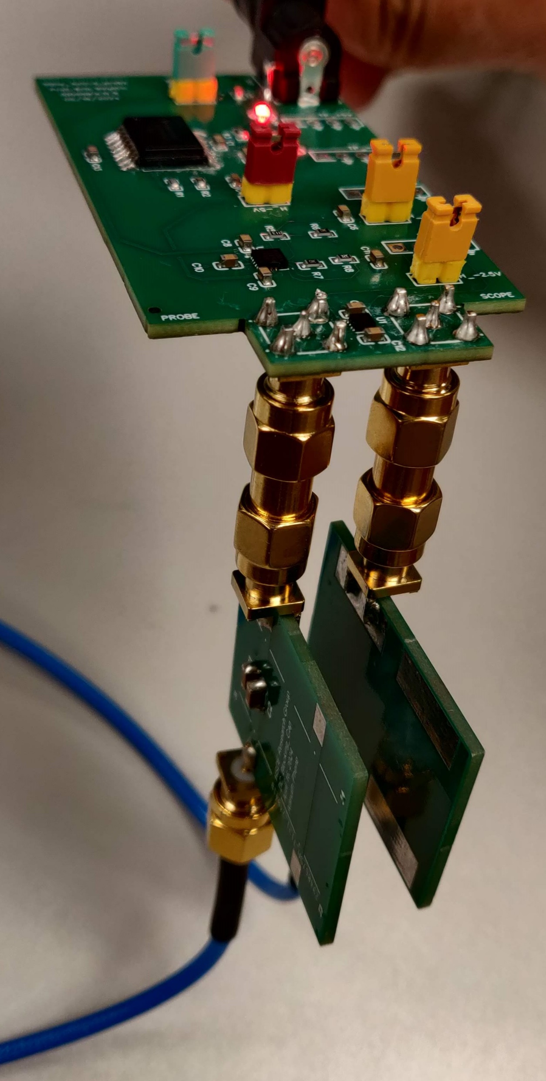
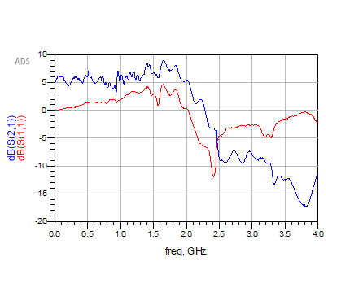
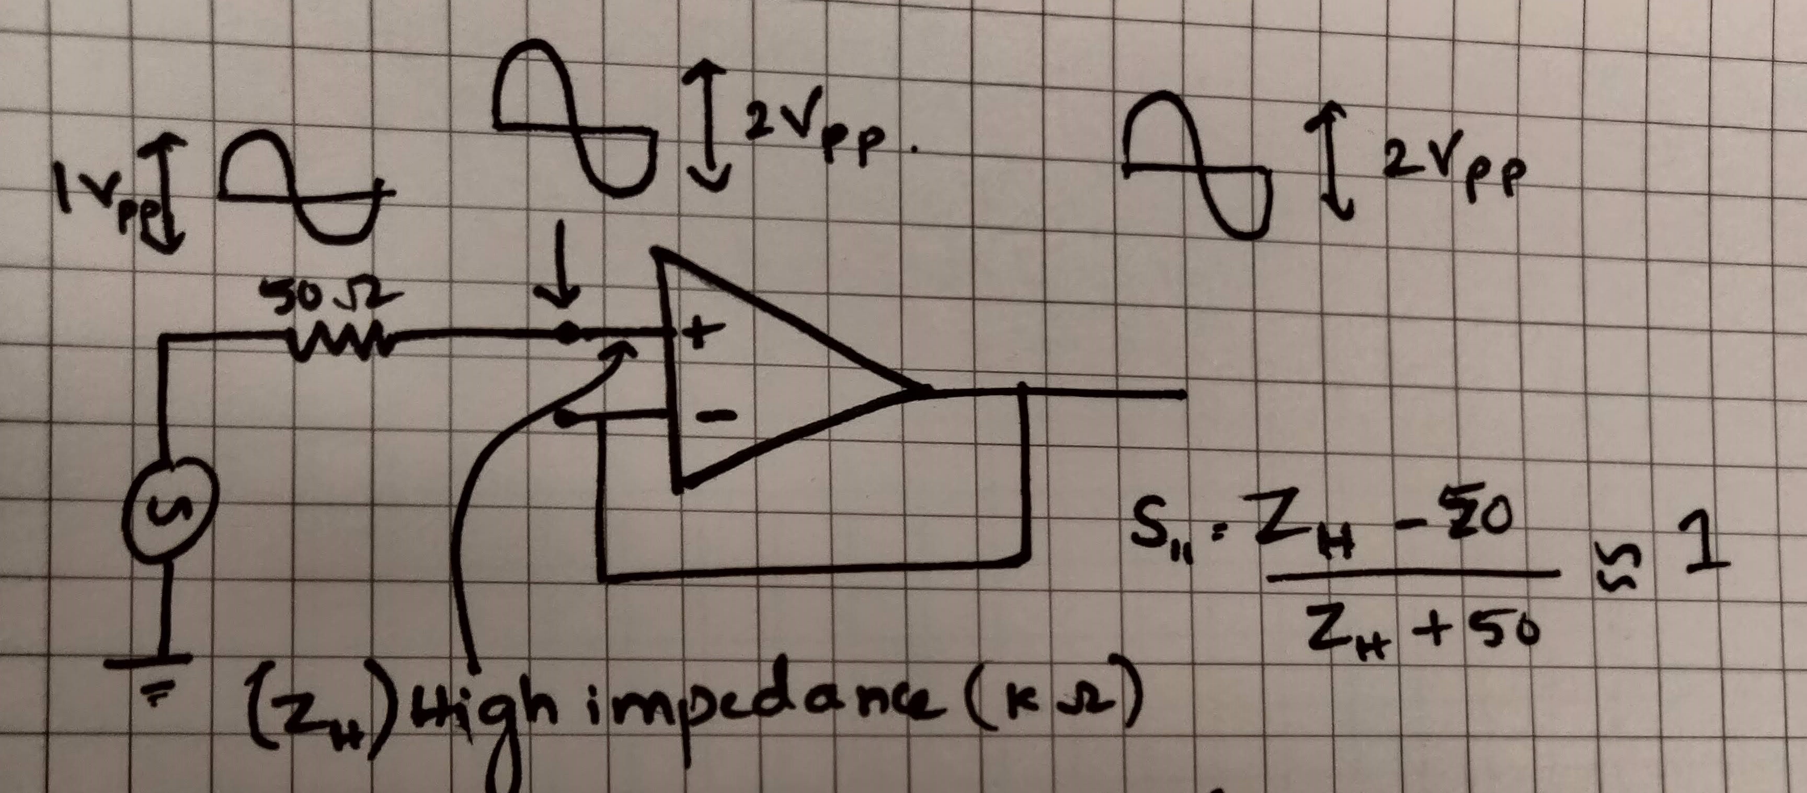
Highlights of the week
Tested the basic working functinalities of designed board using oscilloscope
Measured S-parameters of the probe
Unfortunately, design can measure small signal gain bandwidth upto 2GHz, but not close to the expected 5GHz.
6dB gain

Slide 5
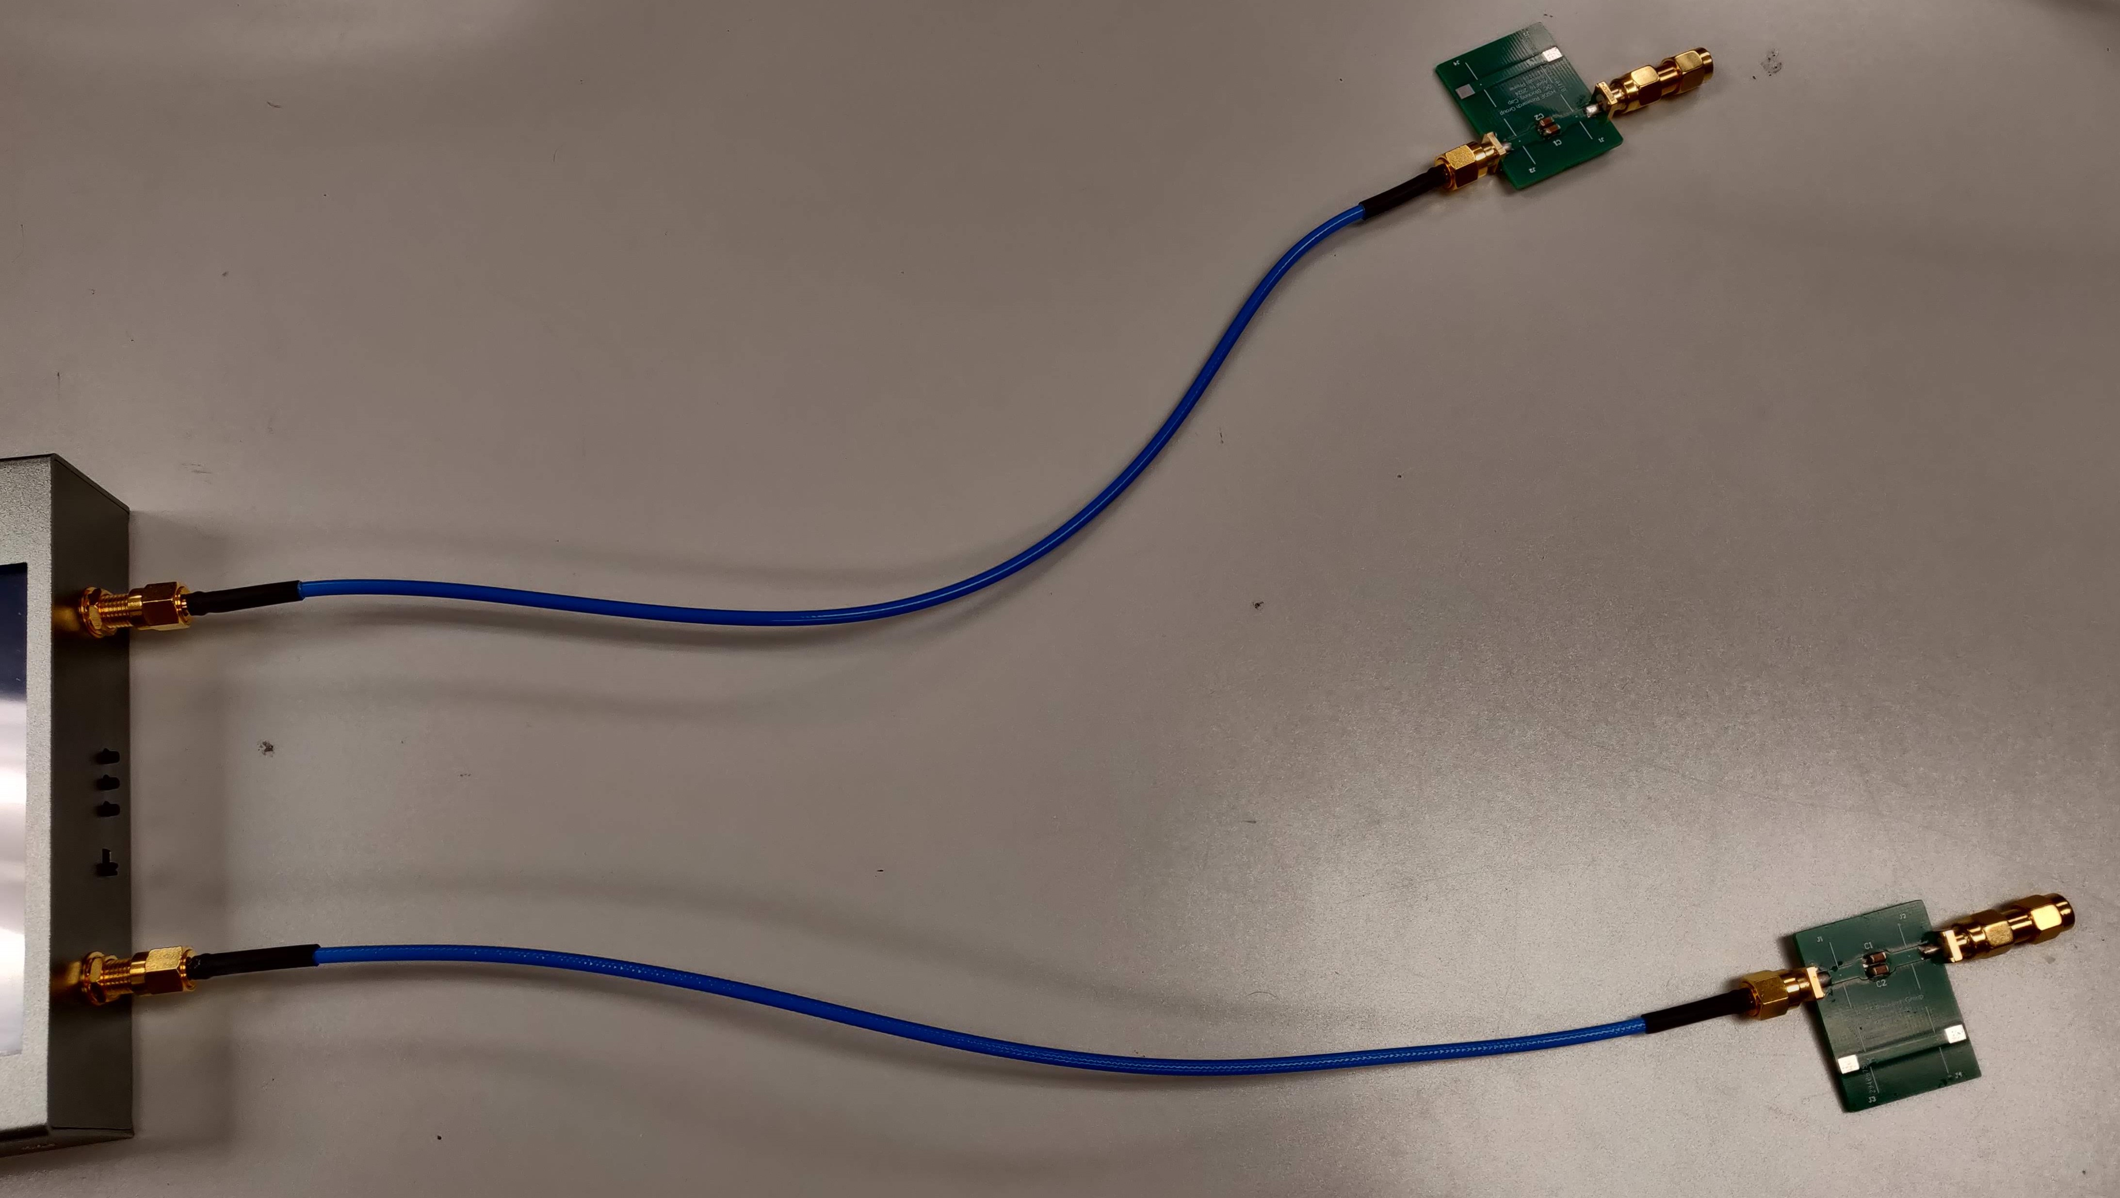
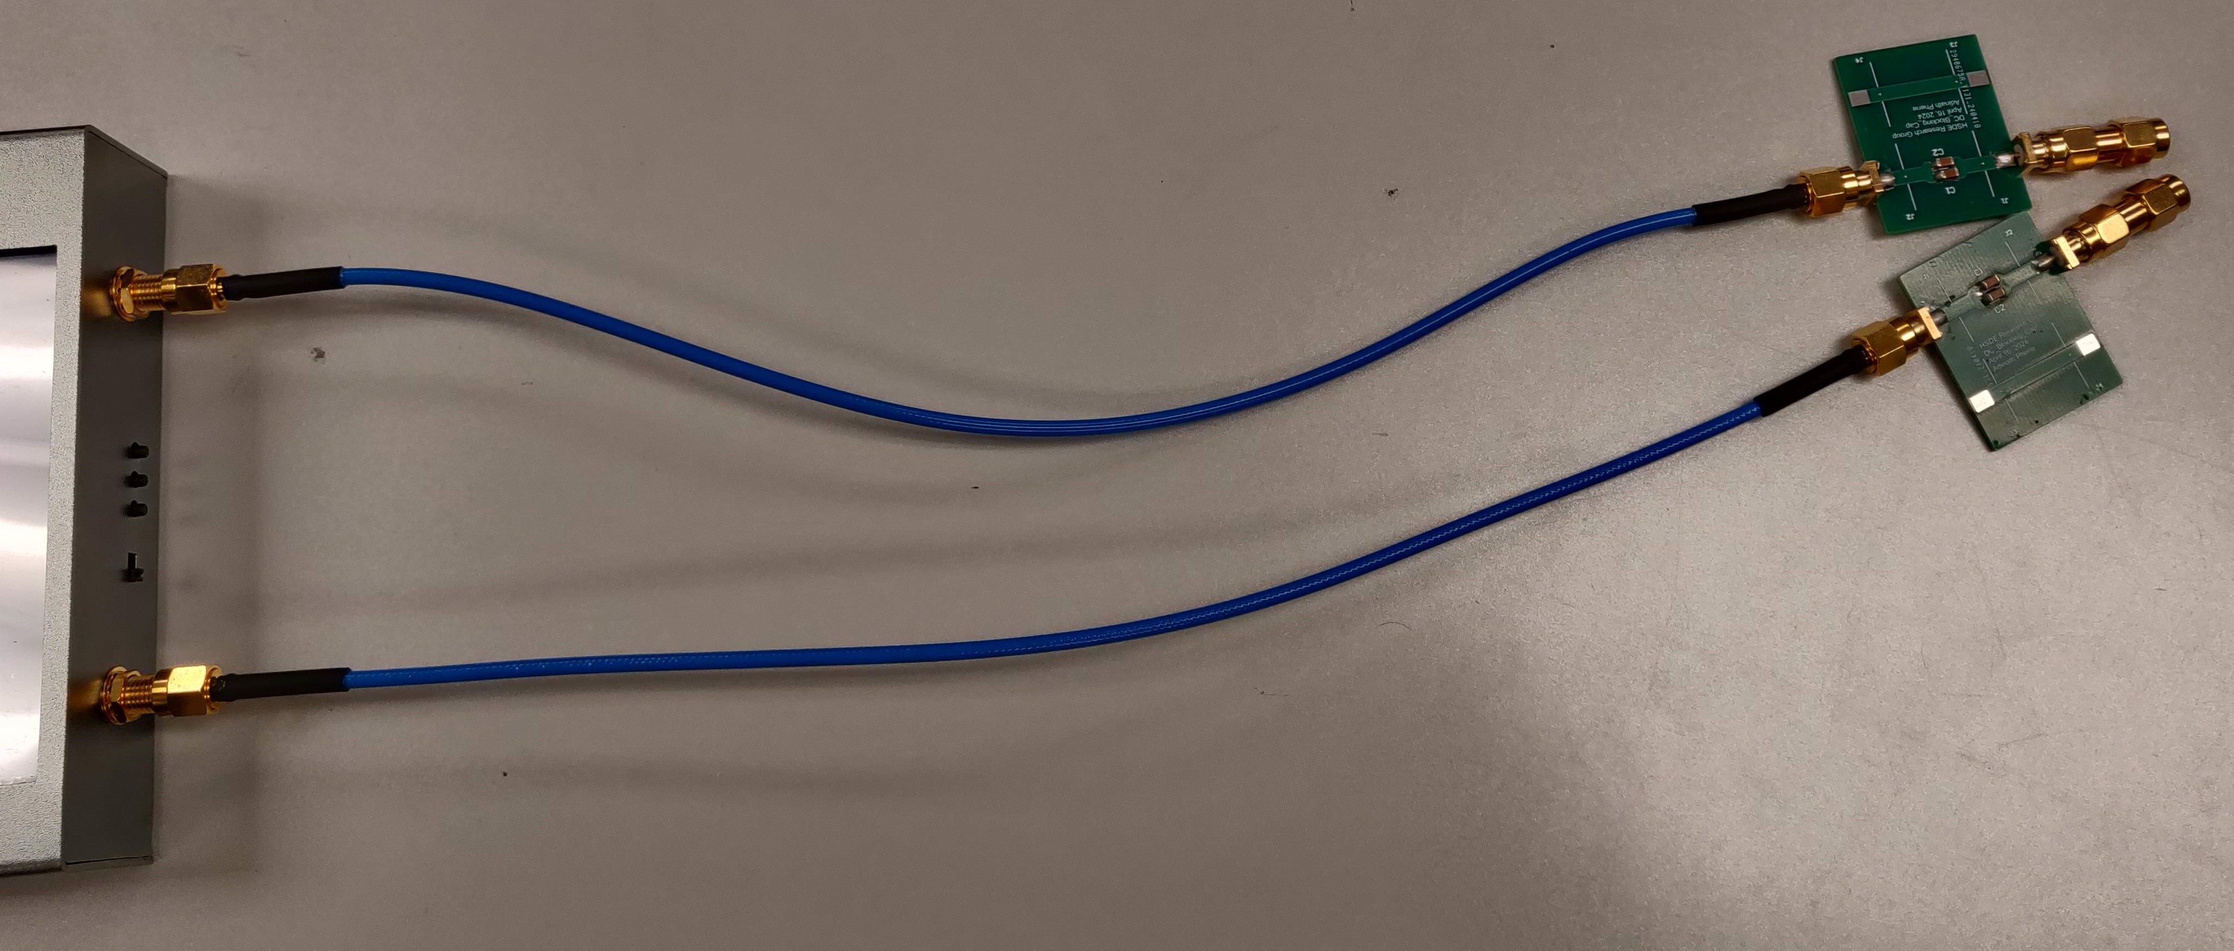
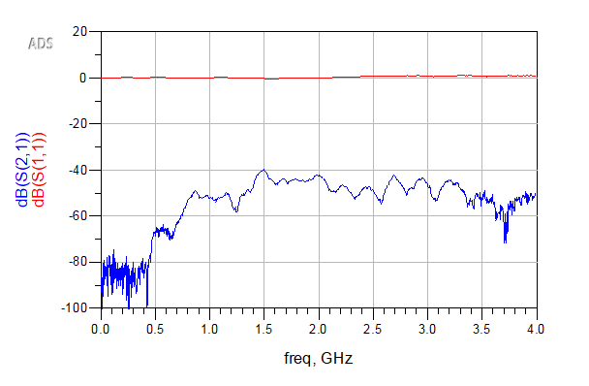
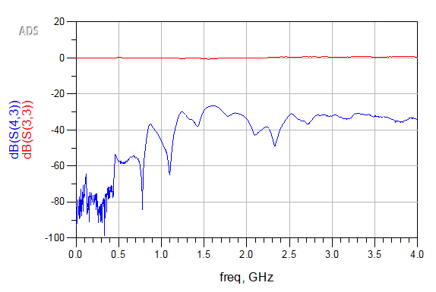
Coupling:
Cable ends are far apart
Cable ends are closer
~-30dB→ 3.1% of the signal voltage
~-45dB→ 0.5% of the signal voltage
V_{coupled} = (3.1- 0.5)% * V_{in} = 2.5% * V_{in}

Slide 6
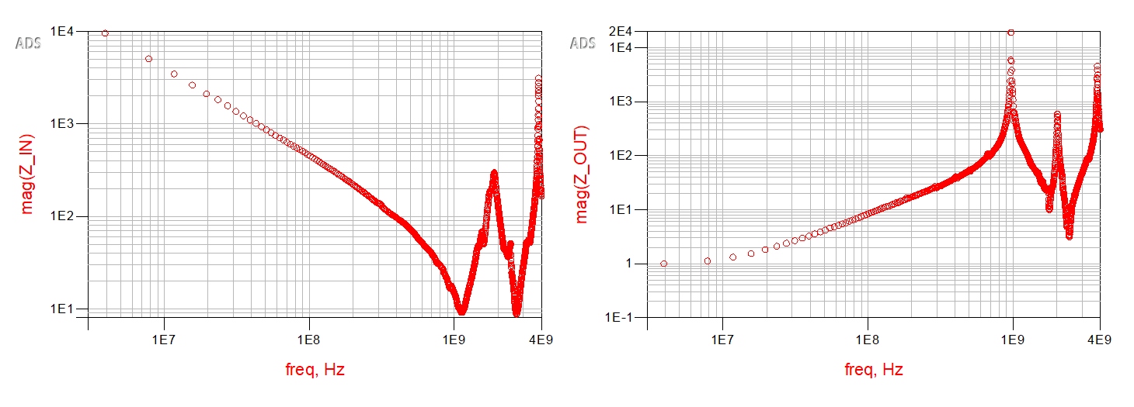
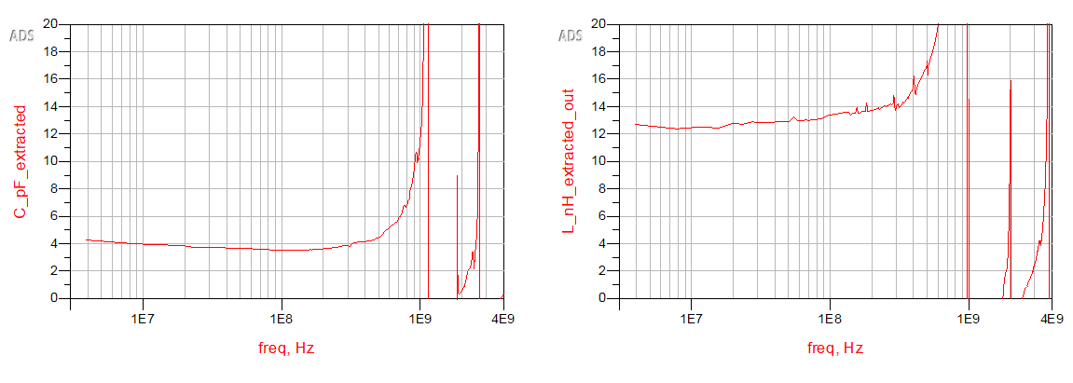
Input and Output Impedance
Input impedance behavior matches capacitance impedance behavior at lower frequencies(C= 1/(2 * pi * f * Z_{C}), and it is around magnitude of 4pF.
Output impedance behaviour matches inductive impedance at lower frequencies(L = Z_{L}/( 2 * pi * f )), and it is around magnitude of 13nH.
13nH
4pF

Slide 7
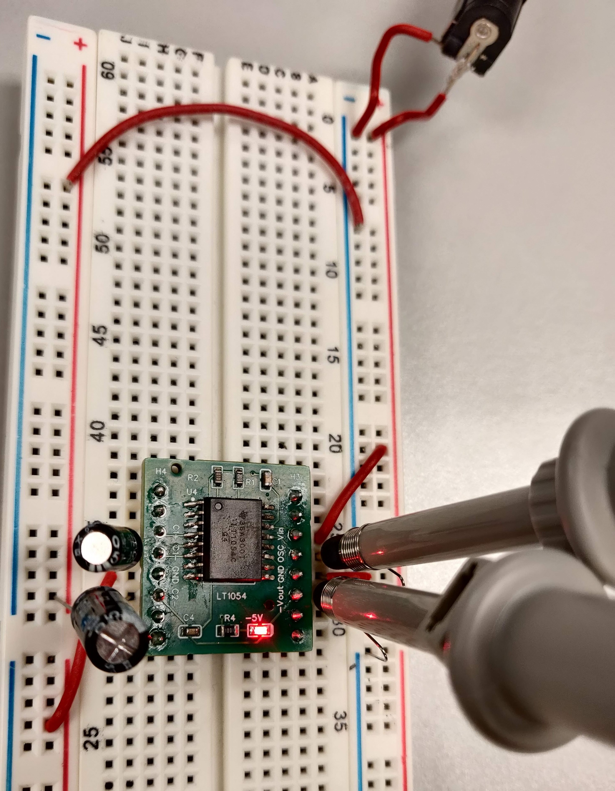
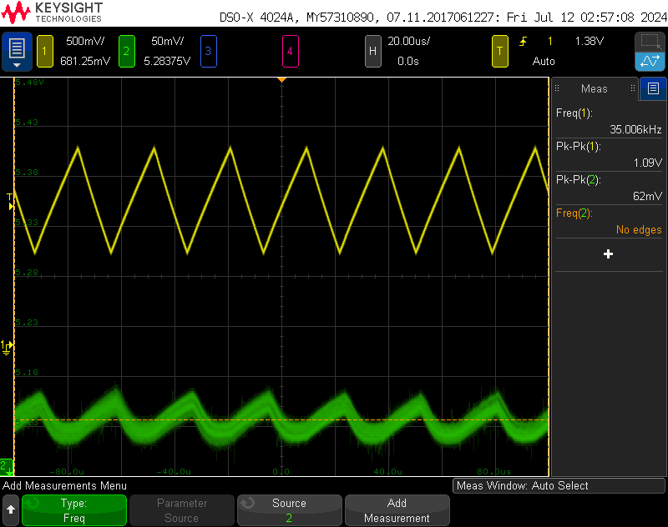
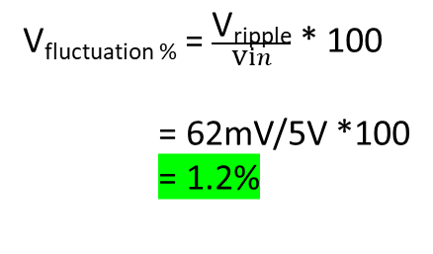
Effect of Inverter(LT1054) on 5V power rail
V_{fluctuation %} = $\frac{\text{V}\text{ripple}}{Vin}$ * 100 = 62mV/5V *100 = 1.2%

Slide 8
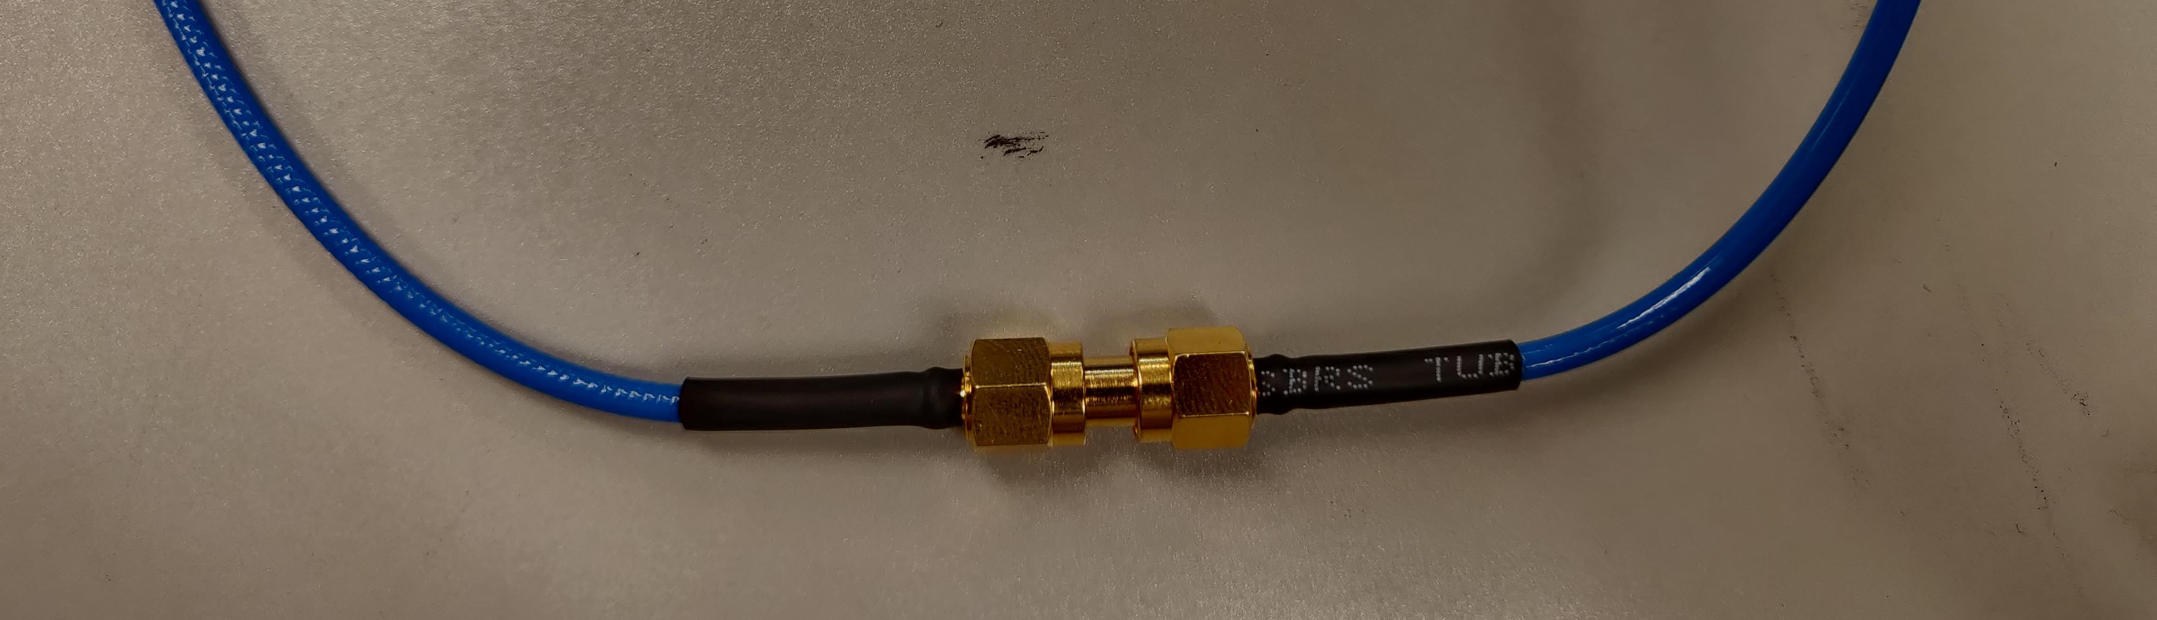
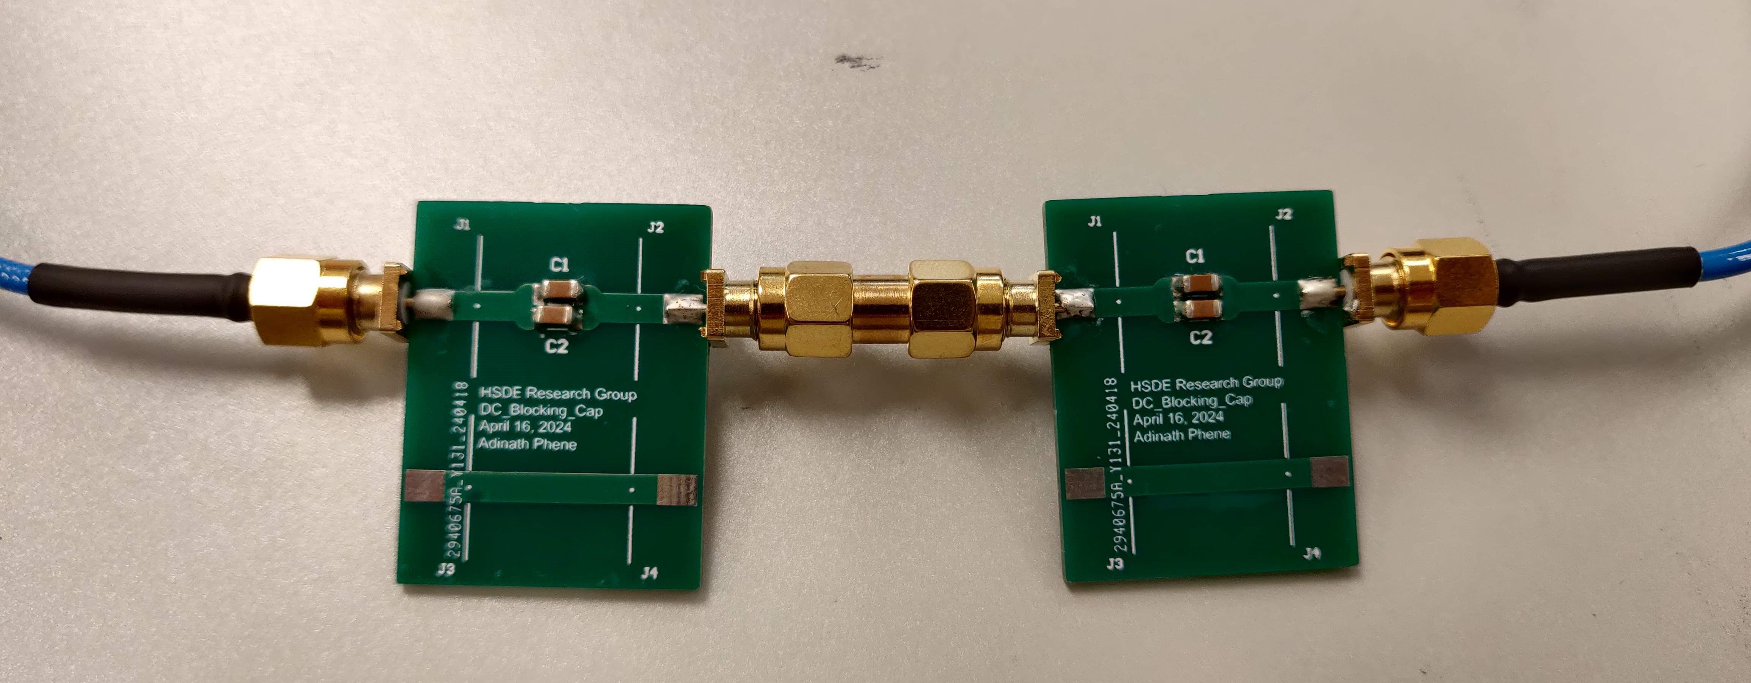
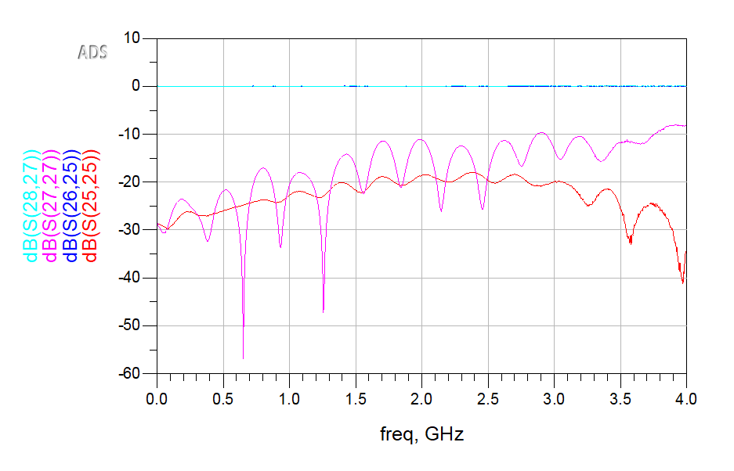
Impact of DC blocking capacitor on Calibration
More return loss(~12dB)
More discontinuity(Magnitude of Ripples increasing with frequency)
Yet to measure and analyze the TDR response…...

Slide 9
Questions?

